Slide 1
Cost Of Attendance
Part 2
College Prep
Mr. Gordon
jgordon@bisdtx.org

Slide 2
Upcoming Events
Fri. Oct. 8th No School
Mon. Oct. 11th BISD Holiday, but 11th graders still have ACC
Thurs. Oct. 14th 6PM CRCA in BISD Homecoming Parade
Sat. Oct. 16th 8AM-2PM 11th Grade PSAT
Fri. Oct. 29th 4:10-9:00 PM CRCA Lock-In $5 Please pay Mr. Gordon Price includes 2 slices of pizza and chips
hi

Slide 3

Cost of Attendance
Now that you know what cost of attendance is, there are usually three kinds of tuitions that universities use:
In-State Tuition
Out-of-State Tuition
Private University
hi

Slide 4
In-State (or Resident) Tuition vs. Out-of-State (or non-Resident)
In-State tuition is the price that a person, who resides in the state (for usually 3 years or more) the university is in, pays to attend there.
For Example
Texas A&M University In-State Tuition- $13,012
Texas A&M University Out-of-State Tuition- $40,896
https://financialaid.tamu.edu/Undergraduate/Cost-of-Attendance#0-CollegeStationUndergraduate
hi

Slide 5
In-State vs. Out-of-State
This means for a student who has lived in Texas for at least three years to attend classes at Texas A&M University,
they would pay $13,012.
For a student from California, Ohio, or Colorado to attend Texas A&M, they would pay $40,896.
This is the same for a Texas resident who wants to attend college in another state. The price difference only applies to tuition, not to room and board, books, etc.
hi

Slide 6

In-State vs. Out-of-State
The reason for the difference is because part of your taxes go to the universities in Texas, so you get a lower price than someone from another state.
This is why it is usually cheapest to attend school in your home state.
hi

Slide 7
If that’s not confusing enough...
Sometimes universities located near a state border will have agreements with states close by.
Meaning, there are some universities in Arkansas, Louisiana, New Mexico, and Oklahoma that Texas residents receive In-State tuition and vice versa.
This option depends on the university, state, and county.
hi

Slide 8
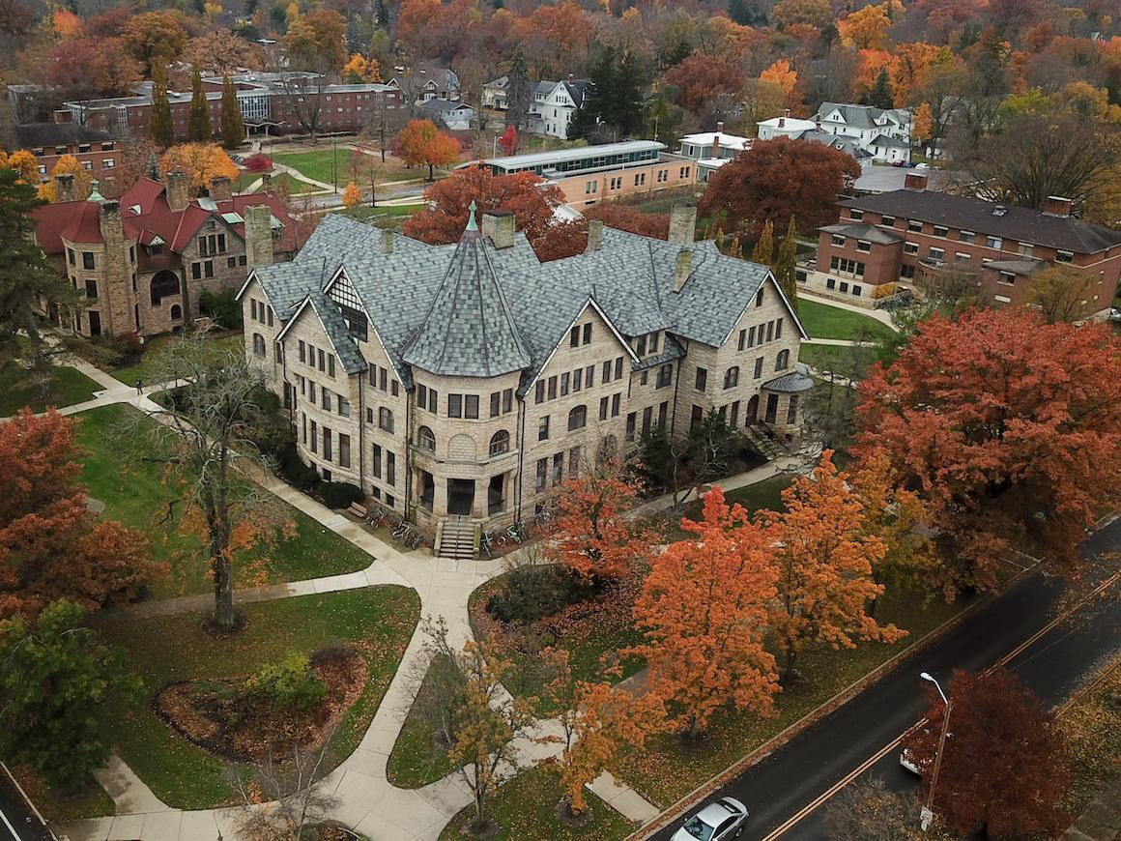

Private University Tuition
Private universities, such as Baylor, Rice, and St. Edward’s, do not receive money from state taxes.
Therefore, private university tuition is the same no matter what state you are from and the university is in.
hi

Slide 9

Private University Tuition
A Texas student attending Baylor pays the same as a person from Iowa and a person from Ohio (my home state) pays the same to attend Oberlin College (an amazing school) as a Texas resident.
BTW Ohio is known for its amazing private schools.
hi

Slide 10
Today’s College Prep Assignment
In the comments section of today’s College Prep,
answer the following question:
Using one of your colleges, is it in-state, out-of-state, or private?
hi

